Slide 1
Neural Network and Deep Learning 23CS8PENDL/23CS7PENDL

Slide 2
Unit-1
Unit-1: An Introduction to Neural Networks: Models of a Neuron, Feedback, Network Architectures, Rosenblatt’s Perceptron: The Perceptron Convergence Theorem, Relation between Perceptron and Bayes Classifier for a Gaussian Environment, The Least-Mean- Square Algorithm: Statistical LMS Learning Theory for Small Learning Rate Parameter, Learning Rate Annealing Schedules
Notes:
To get started with introduction to AI, I would like you to watch this 2 minute from Boston Dynamics
After watching
What you have observed in this video, it is natural or artificial ?
Boston Dynamics a Robotics Company

Slide 3
Introduction to Artificial Neural Network
An Artificial Neural Network (ANN) is an information-processing system inspired by the functioning of the biological nervous system, particularly the human brain.
It attempts to imitate only the fundamental working principles of the brain rather than its complete complexity.
An ANN consists of many interconnected processing elements called neurons that operate together to solve specific tasks.
Similar to humans, an ANN learns from examples through a training process.
Once trained, the network can be applied to particular problems such as spam detection, face recognition, and pattern recognition.

Slide 4
Introduction to Artificial Neural Network
In an ANN, neurons are interconnected through links called connections.
Each connection has an associated weight that represents the importance of the input signal.
The network uses these weighted connections to process information and solve specific problems.
The overall behavior of an ANN is reflected in its ability to learn from data, remember patterns, and generalize to new inputs, similar to the human brain.
ANNs are designed to imitate, in a simplified way, the network of neurons found in biological brains.
Thus, the ANN processing elements are called neurons or artificial neurons.

Slide 5
Models of Neuron
A neuron is an information-processing unit that is fundamental to the operation of a neural network.

Slide 6
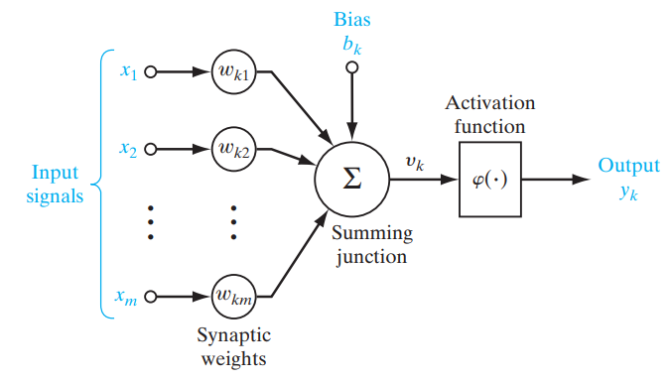
Models of Neuron
A neuron is an information-processing unit that is fundamental to the operation of a neural network.
Three Components of Neuron:
1. Connections: The models
Synaptic interconnections. Synapses,
or connecting links, each of which is
characterized by a weight.
2. Learning: Training or Learning rules
adopted for updating and adjusting the
connection weights. An adder for
summing the input signals,
weighted by the respective synaptic
strengths of the neuron
3. Activation function or
Squashing function:
Activation function for limiting the
amplitude of the output of a neuron.
Model of Neuron

Slide 7
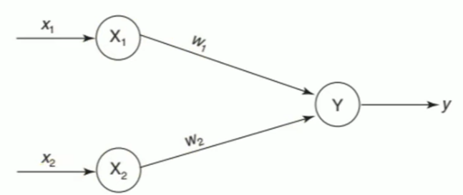
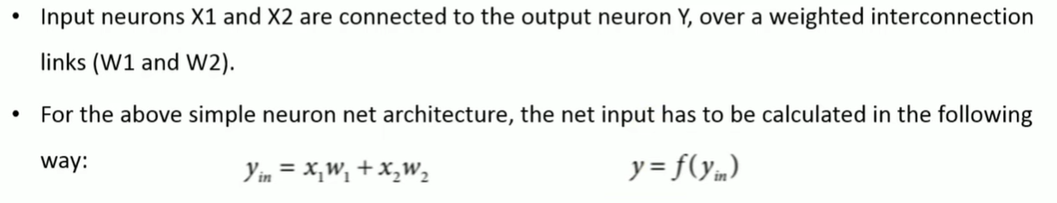
Example to Demonstrate “Model of Neuron”

Slide 8

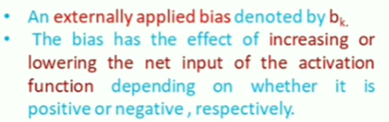
Models of Neuron
This Model of Neuron forms the basis
for designing Artificial Neural Networks

Slide 9
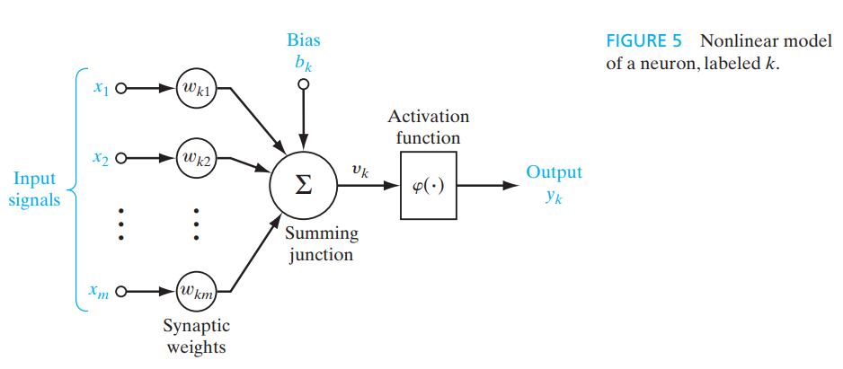
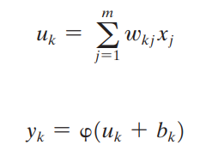
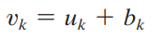
Mathematical terms of Neuron k

Slide 10
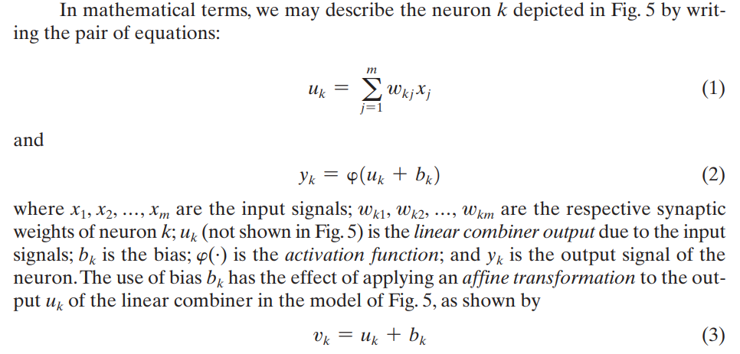
Mathematical terms of Neuron k
Purely linear Up to 𝑣𝑘
Nonlinearity enters after computing 𝑣𝑘,
the neuron applies: 𝑦𝑘 = 𝜑(𝑣𝑘)

Slide 11
Question
Analyze the functional components of a neuron model, focusing on the synapse, adder, and activation function. Present the nonlinear model of a neuron k in mathematical terms, supplemented by a clear and labeled diagram. Define and explain all the terms involved in the equation.

Slide 12
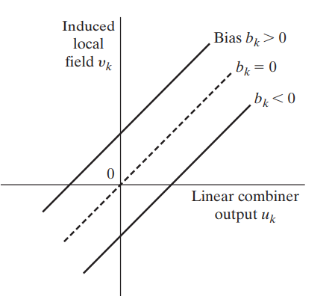
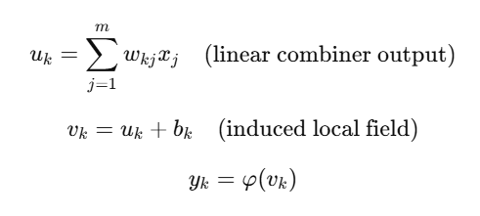
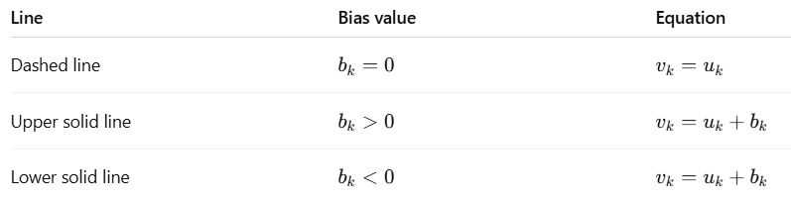
Affine transformation produced by the presence of a Bias
An affine transformation is a geometrical transformation which moves points in space such that points which were lying on a line remain so after the transformation.

Slide 13
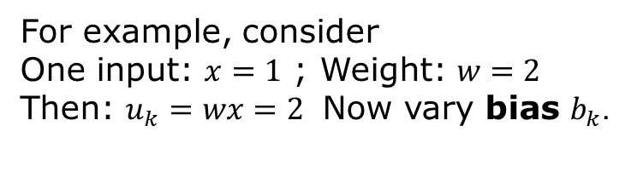
For example, consider
One input: $x=1$ ; Weight: $w=2$
Then: $u_{k}=wx=2$ Now vary bias $b_{k}$.

Slide 14
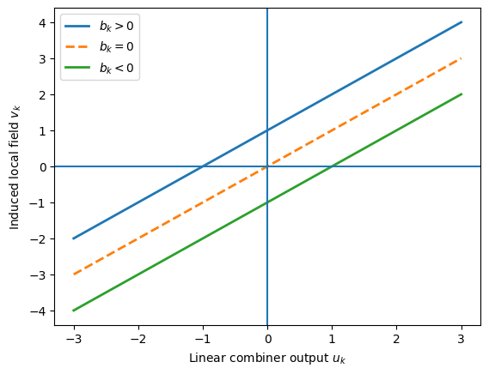
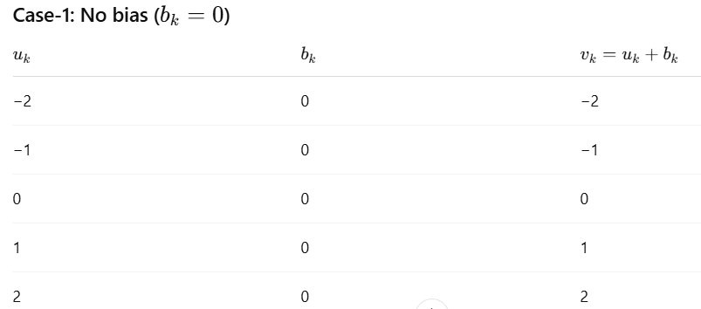
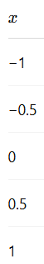
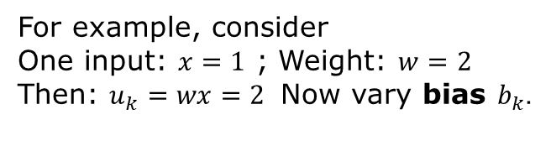
For example, consider
One input: $x=1$ ; Weight: $w=2$
Then: $u_{k}=wx=2$ Now vary bias $b_{k}$.

Slide 15
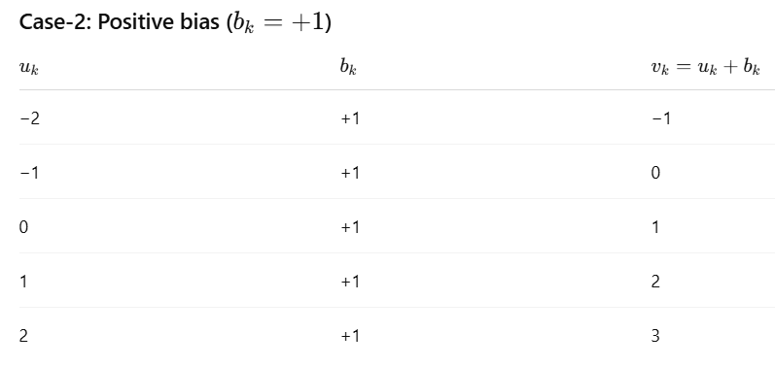
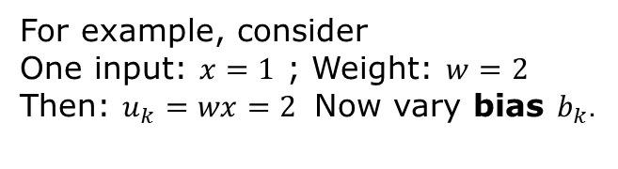
For example, consider
One input: $x=1$ ; Weight: $w=2$
Then: $u_{k}=wx=2$ Now vary bias $b_{k}$.

Slide 16
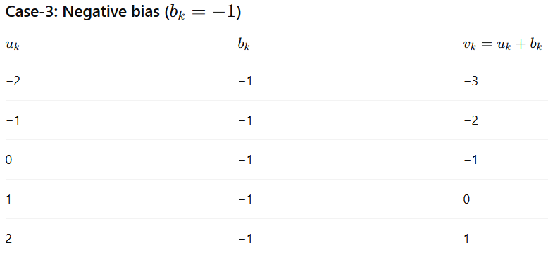
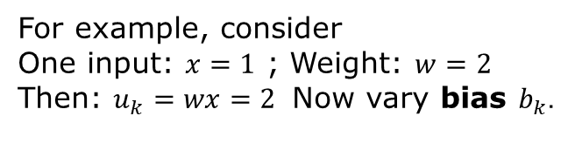
For example, consider
One input: $x=1$ ; Weight: $w=2$
Then: $u_{k}=wx=2$ Now vary bias $b_{k}$.

Slide 17
Why bias is important
Without bias:
Decision boundary must pass through origin
Very restrictive
With bias:
Decision boundary can shift
Neuron becomes more flexible
Bias acts like a threshold

Slide 18
Model of Neuron

Slide 19
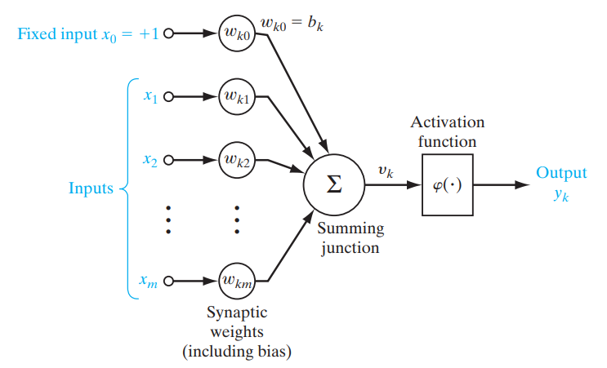
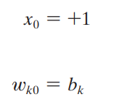
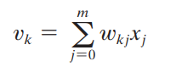
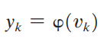
Effect of adding fixed input of '1' with a weight equal to the bias (b_{k})

Slide 20
Question
Identify and analyse three basic elements of the neuron model. Formulate the neuron k using mathematical terms. Compare the effect of adding the bias bk and adding fixed input x0 and show that they are mathematically equivalent.

Slide 21
Types of Activation Function
The activation function, denoted by (φ(v)), defines the output of a neuron:
We identify two basic types of activation functions:
Threshold Function.
Sigmoid Function

Slide 22
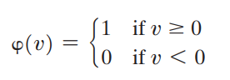
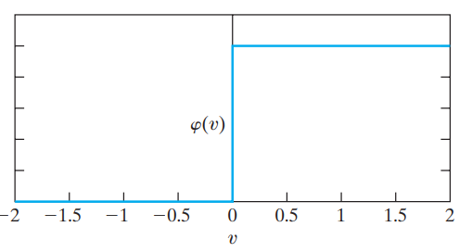
Threshold Activation function

Slide 23
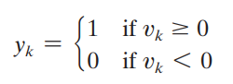
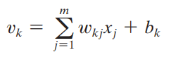
McCulloch–Pitts model
Neuron using “threshold” activation function referred as McCulloch–Pitts model. In this model, the output of a neuron takes on the value of 1 if the induced local field of that neuron is nonnegative, and 0 otherwise.

Slide 24
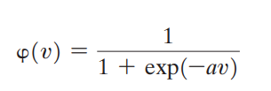
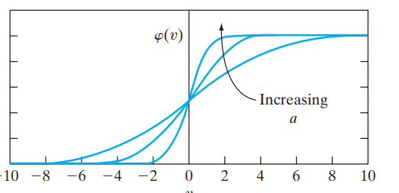
Sigmoid Activation function
The sigmoid function, whose graph is “S”-shaped, is by far the most common form of activation function used in the construction of neural networks. It is defined as a strictly increasing function that exhibits a graceful balance between linear and nonlinear behavior. An example of the sigmoid function is the logistic function, defined by
where a is the slope
parameter of the
sigmoid function
By varying the parameter a,
we obtain sigmoid functions
of different slopes

Slide 25
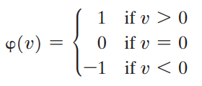
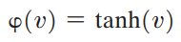
Threshold and Sigmoid Activation functions
Threshold function assumes the value of 0 or 1, a sigmoid function assumes a continuous range of values from 0 to 1. Note also that the sigmoid function is differentiable, whereas the threshold function is not.
Threshold and Sigmoid Activation functions: Range from 0 to 1.
It is sometimes desirable to have the activation function range from -1 to 1, in which case, the activation function is an odd function of the induced local field. Specifically, the threshold function is now defined as
Hyperbolic tangent function, defined by

Slide 26
Question
Analyze the behavior of the Sigmoid and Threshold activation functions in the training and performance of the Neural Networks. Justify how does one activation function be preferred over the other.

Slide 27
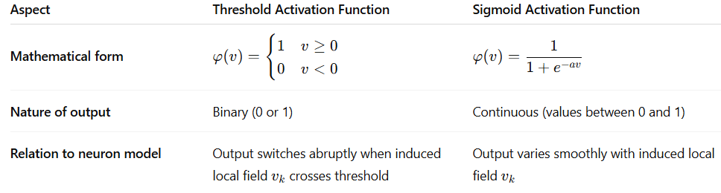
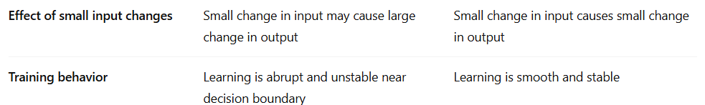
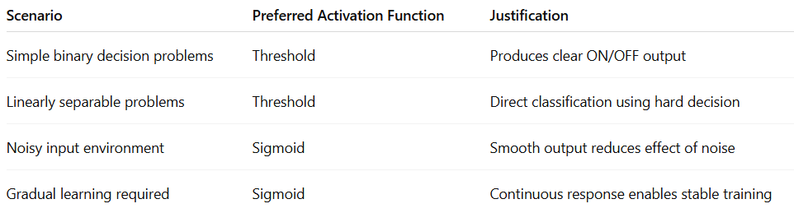
Notes:
The threshold activation function produces a hard decision suitable for simple classification, whereas the sigmoid activation function provides a smooth and differentiable response, leading to stable learning and better performance in neural networks.

Slide 28
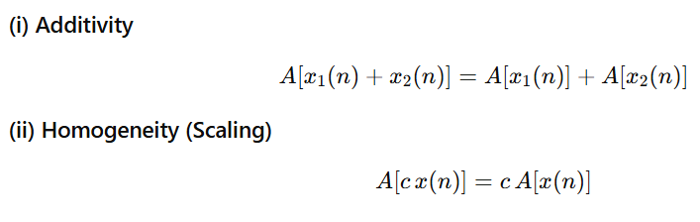
Linear System
A system is linear if it satisfies both:
- A is operator
- Signals x₁(n) and x₂(n) are functions of the discrete-time variable n

Slide 29
Feedback
Feedback is said to exist in a dynamic system whenever the output of an element in the system influences in part the input applied to that particular element, thereby giving rise to one or more closed paths for the transmission of signals around the system.
Indeed, feedback occurs in almost every part of the nervous system of every animal.
Moreover, it plays a major role in the study of a special class of neural networks known as recurrent networks.

Slide 30
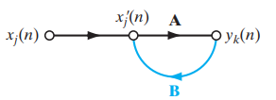
Feedback
Signal-flow graph of a single-loop feedback system
Input signal x_{j} (n), internal signal x’_{j} (n), and output signal y_{k}(n) are functions of the discrete-time variable n.
The system is assumed to be linear, consisting of
a forward path and a feedback path that are characterized by the “operators” A and B, respectively.

Slide 31
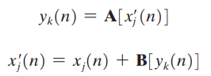
Feedback
Signal-flow graph of a single-loop feedback system

Slide 32
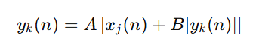
Feedback
Substitute for x’_{j}(n)

Slide 33
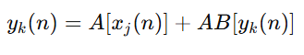
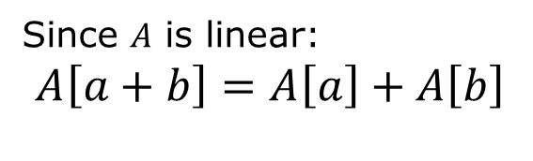
Feedback
Substitute for x’j(n)
Since $A$ is linear:
$$A\left[a+b\right]=A\left[a\right]+A\left[b\right]$$

Slide 34
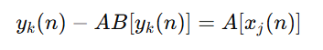
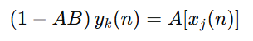
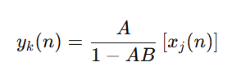
Feedback

Slide 35
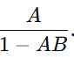
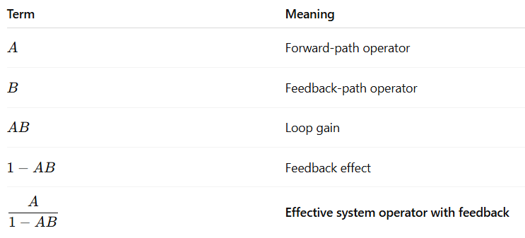

Feedback
Feedback modifies the effective gain
of the system from $A$ to

Slide 36
Question
Analyze the influence of feedback in the neural networks. Obtain the expressions input signal x_{j}(n), internal signal x’_{j} (n) and output signal y_{k}(n).

Slide 37
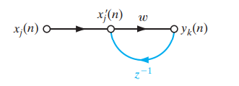
Feedback
Signal-flow graph of a first-order,
infinite-duration impulse response (IIR) filter.

Slide 38
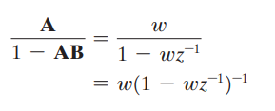
Feedback
Signal-flow graph of a first-order,
infinite-duration impulse response (IIR) filter.
- A is a fixed weight w and
- B is a unit-delay operator z⁻¹ ,
whose output is delayed with respect
to the input by one time unit.

Slide 39
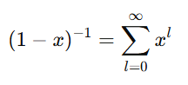
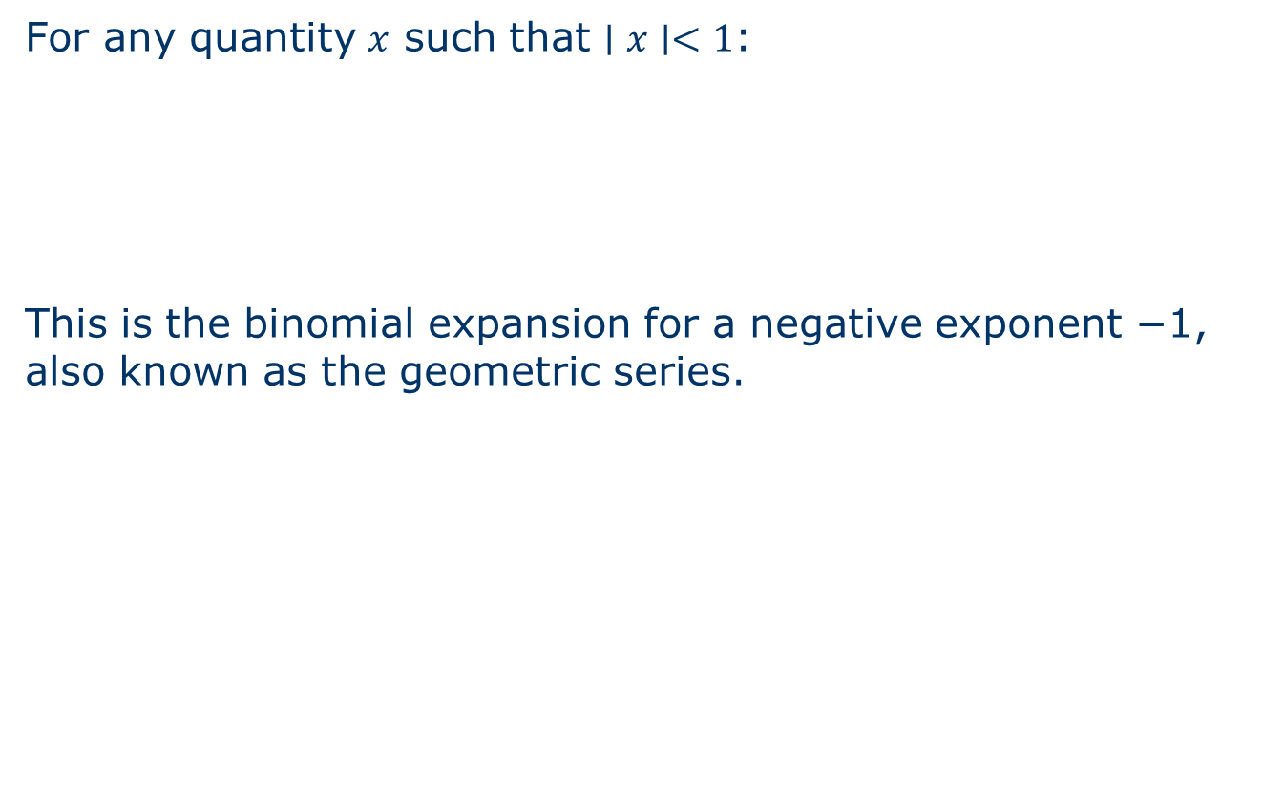
Recall the binomial (geometric) expansion
For any quantity $x$ such that $∣x∣<1$:
This is the binomial expansion for a negative exponent −1, also known as the geometric series.

Slide 40


Recall the binomial (geometric) expansion
For any quantity $x$ such that $∣x∣<1$:
This is the binomial expansion for a negative exponent −1, also known as the geometric series.
Identify x=wz⁻¹

Slide 41


Recall the binomial (geometric) expansion
For any quantity $x$ such that $∣x∣<1$:
This is the binomial expansion for a negative exponent −1, also known as the geometric series.
Identify x=wz⁻¹

Slide 42

Feedback
Binomial Expansion
Using the binomial expansion for (1 - wz⁻¹)⁻¹ ,
we may rewrite the closed-loop operator of the system as

Slide 43

Feedback

Slide 44

Feedback
From the definition of z⁻¹ , we have
where x_{j}(n – l ) is a sample of the
input signal delayed by l time units.

Slide 45

Feedback
From the definition of z⁻¹ , we have
where x_{j}(n – l ) is a sample of the
input signal delayed by l time units.

Slide 46

Feedback
Suppose that, for some power N, |w| is small enough relative to
unity such that w^{N} is negligible for all practical purposes.

Slide 47



Feedback
Time response for three different values of feedforward weight
(a) Stable. (b) Linear divergence. (c) Exponential divergence.

Slide 48

Feedback

Slide 49


If $∣w∣<1$, feedback
weakens the signal,
and the system is stable.

Slide 50


If $∣w∣=1$, feedback
accumulates uniformly,
causing linear growth.

Slide 51


If $∣w∣>1$, feedback
amplifies the signal
exponentially, making
the system unstable.

Slide 52


Feedback: Summary

Slide 53
Network Architectures
The manner in which the neurons of a neural network are structured is intimately linked with the learning algorithm used to train the network.
We may therefore speak of learning algorithms (rules) used in the design of neural networks as being structured.
Three fundamentally different classes of network architectures
Single-Layer Feedforward Networks
Multilayer Feedforward Networks
Recurrent Networks

Slide 54

Single-Layer Feedforward Networks
In a layered neural network, the neurons are organized in the form of layers.
In the simplest form of a layered network, we have an input layer of source nodes that projects directly onto an output layer of neurons (computation nodes), but not vice versa.
In other words, this network is strictly of a feedforward type.
Network is called a single-layer network, with the designation “single-layer” referring to the output layer of computation nodes (neurons). We do not count the input layer of source nodes because no computation is performed there.

Slide 55

Multilayer Feedforward Networks
Multilayer Feedforward Networks distinguishes itself by the presence of one or more hidden layers, whose computation nodes are correspondingly called hidden neurons or hidden units;
the term “hidden” refers to the fact that this part of the neural network is not seen directly from either the input or output of the network.
Hidden layers are important because they: Extract features, Transform input space into a form where output becomes easy.
“Hidden” nodes: Simple analogy
Think of a calculator:
You enter numbers (input)
You get the answer (output)
You do not see the internal steps.
In a car: you press accelerator → car moves
You don’t see the combustion happening inside.
Hidden neurons are
visible to the designer,
but invisible to the user.
Fully connected feedforward network
with one hidden layer and one output layer.
Fully connected in the sense that every node
in each layer of the network is connected to
every other node in the adjacent forward layer.

Slide 56



Recurrent Networks
A recurrent neural network distinguishes itself from a feedforward neural network in that it has at least one feedback loop.
For example, a recurrent network may consist of a single layer of neurons with each neuron feeding its output signal back to the inputs of all the other neurons.
Feedback loops involve the use of particular branches composed of unit-time delay elements (denoted by z⁻¹ ), which result in a nonlinear dynamic behavior, assuming that the neural network contains nonlinear units.
z⁻¹ : Output at time 𝑛 comes back as input at time 𝑛+1
Recurrent network with no self-feedback loops
and no hidden neurons.
Unit-time delay element $z^{−1}$stores a signal for
one time step and feeds it back later, giving
the recurrent network memory.
Now output depends on past
output. This gives the network MEMORY.
So neurons are influenced by:
- Current inputs
- Past neuron outputs

Slide 57
Network Architectures
Question
1. Compare and contrast single-layer feedforward networks, multilayer feedforward networks, and recurrent networks in terms of their structural differences, representational power, and suitability for different types of data and tasks with suitable diagrams.
2. Identify and describe the any two fundamentally different classes of neural network architectures.

Slide 58


McCulloch–Pitts model
Warren
Sturgis McCulloch
Walter Harry
Pitts
The first computational model of a neuron was proposed by Warren McCulloch (neuroscientist) and Walter Pitts (logician) in 1943.
It takes multiple binary inputs, each with its associated weight. The inputs can be either 0 or 1, and the weights represent the strength of the connection between inputs and the neuron.
The model includes a threshold value (often denoted as "θ" or "bias"). The neuron will only fire (output 1) if the weighted sum of its inputs exceeds this threshold.
It can be used to implement basic logic gates like AND, OR, and NOT.
McCulloch Pitts model has limitations, such as not being able to model complex or non-linearly separable functions like XOR.

Slide 59
McCulloch–Pitts model
Warren
Sturgis McCulloch
Walter Harry
Pitts
The first computational model of a neuron was proposed by Warren MuCulloch (neuroscientist) and Walter Pitts (logician) in 1943.
It takes multiple binary inputs, each with its associated weight. The inputs can be either 0 or 1, and the weights represent the strength of the connection between inputs and the neuron.
The model includes a threshold value (often denoted as "θ" or "bias"). The neuron will only fire (output 1) if the weighted sum of its inputs exceeds this threshold.
It can be used to implement basic logic gates like AND, OR, and NOT.
McCulloch Pitts model has limitations, such as not being able to model complex or non-linearly separable functions like XOR.

Slide 60


Logic gate AND function: Using McCulloch–Pitts model
The McCulloch-Pitts neuron fires if $\sum_{i=1}^{n}{w_{i}}x_{i}≥θ$
Weights:
$w_{1}=w_{2}=w3 (acts as bis)=1$
Threshold: $θ=3$
Function:
$y=1$ if $\sum_{i=1}^{3}{w_{i}}x_{i}≥3$ , else $y=0$

Slide 61





Key McCulloch-Pitts Threshold Configurations:

Slide 62


Key McCulloch-Pitts Threshold Configurations:

Slide 63

Rosenblatt’s Perceptron Model
Frank Rosenblatt
Perceptron was conceptualized by Frank Rosenblatt in the year 1957 and it is the most primitive form of artificial neural networks.
Perceptron built upon the idea, laid down by McCulloch-Pitts neuron, to create true machine learning model.
Main differences: Introduction of numerical weights for inputs and a mechanism for learning these weights.

Slide 64


Rosenblatt’s Perceptron Model
Frank Rosenblatt
Perceptron was conceptualized by Frank Rosenblatt in the year 1957 and it is the most primitive form of artificial neural networks.
Perceptron built upon the idea, laid down by McCulloch-Pitts neuron, to create true machine learning model.
Main differences: Introduction of numerical weights for inputs and a mechanism for learning these weights.
Synaptic weights of the perceptron are denoted by
w₁,w₂,...,w_{m}.
Inputs applied to the perceptron are x₁, x₂,..., x_{m} .
Bias b
Goal of the perceptron is to correctly classify
inputs x₁, x₂,..., x_{m} into one of two classes, c1 or c2
Decision rule for the classification is to assign the
inputs x₁, x₂,..., x_{m} to class c1 if the perceptron
output y is +1 and to class c2 if it is -1.
Signal-flow graph of the perceptron.

Slide 65

Linear and Nonlinear Separable Classes
(a) A pair of linearly separable patterns. (b) A pair of non-linearly separable patterns.

Slide 66




Limitations of Single Layer Perceptron
XOR

Slide 67
Perceptron Convergence Theorem Proof

Slide 68



Cauchy–Schwarz inequality
Cauchy–Schwarz inequality states that the square of the dot product of two vectors is less than or equal to the product of the squares of their magnitudes:
The norm (|| ||) of a vector is its length or magnitude,
calculated as the square root of the sum of the squares of its components

Slide 69

Convergence
Newton-Raphson’s Method example:
In mathematics, Convergence essentially means “getting closer and closer to a value” without necessarily reaching it (in the case of infinite limits).
Convergence in the context of perceptron can be understood as the condition where the weight gets no more updates and the previous iteration weight w_i is very close to the present new weight w_i+1 such that the perceptron makes correct classification with the converged weights.

Slide 70
Convergence Theorem Statement
If the data is linearly separable, the perceptron learning algorithm will converge to a set of weights that correctly classify the training data after a finite number of updates.

Slide 71

Perceptron Convergence Theorem

Slide 72

Perceptron Convergence Theorem

Slide 73

Perceptron Convergence Theorem

Slide 74

Perceptron Convergence Theorem

Slide 75

Perceptron Convergence Theorem

Slide 76

Perceptron Convergence Theorem
Illustration of the hyperplane (in this example,
a straight line) as decision boundary for a
two-dimensional, two-class pattern-classification
problem.

Slide 77
Perceptron Convergence Theorem

Slide 78

Perceptron Convergence Theorem: Proof of COnvergence

Slide 79

Perceptron Convergence Theorem: Proof of Convergence

Slide 80

Perceptron Convergence Theorem: Proof of Convergence
Notes:
$$w_{0}$$
𝑤 subscript)
or
$w\left(0\right)$ )function)

Slide 81



Perceptron Convergence Theorem: Proof of Convergence

Slide 82
Perceptron Convergence Theorem: Proof of Convergence
T

Slide 83



Perceptron Convergence Theorem: Proof of Convergence

Slide 84


Perceptron Convergence Theorem: Proof of Convergence

Slide 85

Perceptron Convergence Theorem

Slide 86


Perceptron Convergence Theorem: Proof of Convergence

Slide 87

Perceptron Convergence Theorem: Proof of Convergence

Slide 88

Summary of the Perceptron Convergence Algorithm

Slide 89

Summary of the Perceptron Convergence Algorithm
Signum function
Adaptation of the weight vector w(n) is
summed up in the form of the
error-correction learning rule.
η is the learning-rate parameter and
the difference d(n) - y(n) plays the role
of an error signal.
0 < η <=1.

Slide 90
Summary of the Perceptron Convergence Algorithm
Signum function
Adaptation of the weight vector w(n) is
summed up in the form of the
error-correction learning rule.
η is the learning-rate parameter and
the difference d(n) - y(n) plays the role of an error signal.
0 < η <=1.

Slide 91


Slide 92


Slide 93

No Change in
Target and Output
Hence no Update in weight

Slide 94

Using the final weights (w1, w2, w3, w4)=(-2,2,0,2) and bias as 0, we can classify the given inputs correctly

Slide 95
Rosenblatt’s Perceptron: The Perceptron Convergence Theorem
Questions:
1. Analyze the design of Rosenblatt’s perceptron for the Mc Culloch-Pitts model of a neuron. Show the summing of the linear combination of the inputs applied on synapses using the signal- flow graph of the perceptron with appropriate mathematical equations.
2. Derive the error correction learning algorithm for the perceptron using the perceptron convergence theorem. Formulate the algorithm for adapting the weight vector of the elementary perceptron.
3. Derive the weight update rule for the perceptron using the perceptron convergence theorem. Develop the error correction learning algorithm for adjusting the weight vector in a basic perceptron model.
4. Identify and describe the steps involved in training a perceptron from initialization to the adaptation of the weight vector. Specifically, explain how the input vector, weight vector, and learning-rate parameter are used in the computation and adaptation steps.

Slide 96
Relation between Perceptron and Bayes Classifier for a Gaussian Environment
Bayes Classifier
Bayes Classifier for a Gaussian Distribution

Slide 97






Probability Density Function
For x=14mm, Probability density if tumor is Benign
Notes:
These curves are nothing but $p\left(x∣Benign\right)$and $p\left(x∣Malignant\right)$— the class-conditional densities required for Bayes classifier

Slide 98


Cost Matrix
R1
R2
Risk: The Bayes classifier models risk by selecting the class that minimizes expected loss, using posterior probabilities to calculate the minimum possible classification error, known as the Bayes risk.
Notes:
This cost matrix tells Bayes: it is safer to over-diagnose than to miss a cancer.”

Slide 99


R1
R2
Risk
Notes:
This cost matrix tells Bayes: it is safer to over-diagnose than to miss a cancer.”

Slide 100
Bayes Classifier
In the Bayes classifier, or Bayes hypothesis testing procedure, we minimize the average risk, denoted by r. For a two-class problem, represented by classes c1 and c2, the average risk is defined by
Cost Matrix
R1
R2

Slide 101




Similarly
R1
R2

Slide 102


Slide 103




Slide 104



Replace the $R_{2}$integral again
Use
Substitute

Slide 105


Final grouping

Slide 106




Fixed Cost
So to minimize risk, we must make this integral as small as possible.
To make the total sum small, each small term must be ≤ 0
wherever we include it in $R_{1}$.
Notes:
What this means physically (tumor example)
At that $x$:
Left term = cost-weighted support for Malignant
Right term = cost-weighted support for Benign
If malignant support is smaller, put that $x$into Benign region $R_{1}$.
Because including it there reduces total risk.
What this means physically (tumor example)
At that $x$:
Left term = cost-weighted support for Malignant
Right term = cost-weighted support for Benign
If malignant support is smaller, put that $x$into Benign region $R_{1}$.
Because including it there reduces total risk.

Slide 107
Fixed Cost
Malignant Support
Benign Support
Notes:
What this means physically (tumor example)
At that $x$:
Left term = cost-weighted support for Malignant
Right term = cost-weighted support for Benign
If malignant support is smaller, put that $x$into Benign region $R_{1}$.
Because including it there reduces total risk.
What this means physically (tumor example)
At that $x$:
Left term = cost-weighted support for Malignant
Right term = cost-weighted support for Benign
If malignant support is smaller, put that $x$into Benign region $R_{1}$.
Because including it there reduces total risk.

Slide 108



Fixed Cost
We want to minimize R
The only thing we control is what values of $x$we put into $R_{1}$
For a particular $x$, should I include it in $R_{1}$or not?”
Notes:
What this means physically (tumor example)
At that $x$:
Left term = cost-weighted support for Malignant
Right term = cost-weighted support for Benign
If malignant support is smaller, put that $x$into Benign region $R_{1}$.
Because including it there reduces total risk.
What this means physically (tumor example)
At that $x$:
Left term = cost-weighted support for Malignant
Right term = cost-weighted support for Benign
If malignant support is smaller, put that $x$into Benign region $R_{1}$.
Because including it there reduces total risk.

Slide 109

The first two terms on the right-hand side of Eq. represent a fixed cost. Since the requirement is to minimize the average risk , we may therefore deduce the following strategy from Eq. for optimum classification:

Slide 110



p
p
is called the threshold of the test
∧(x), the ratio of two conditional
probability density functions,
is called the likelihood ratio

Slide 111

is called the threshold of the test
∧(x), the ratio of two conditional
probability density functions,
is called the likelihood ratio
Decide C1 if
> threshold
Otherwise decide C2

Slide 112

Two equivalent implementations of the Bayes classifier:
1. Likelihood ratio test

Slide 113

Two equivalent implementations of the Bayes classifier:
1. Likelihood ratio test
2. Log-likelihood ratio test.
From a computational point of view,
we find it more convenient to work with
the logarithm of the likelihood ratio rather than
the likelihood ratio itself. We are permitted to
do this for two reasons. First, the logarithm is a
monotonic function. Second, the likelihood ratio
and threshold are both positive. Therefore,
the Bayes classifier may be implemented
in the equivalent form shown in the figure.

Slide 114
Two equivalent implementations of the Bayes classifier:
1. Likelihood ratio test
The important points in this block diagram are twofold:
1. The data processing involved in designing the Bayes
classifier is confined entirely to the computation of the
likelihood ratio
2. This computation is completely invariant to the
values assigned to the prior probabilities and costs
involved in the decision-making process.
These quantities merely affect the value of the threshold
2. Log-likelihood ratio test.

Slide 115
Relation between Perceptron and Bayes Classifier for a Gaussian Environment
Bayes Classifier
Bayes Classifier for a Gaussian Distribution

Slide 116

Bayes Classifier for a Gaussian Distribution
Consider now the special case of a two-class problem, for which the underlying distribution is Gaussian. The random vector X has a mean value that depends on whether it belongs to class C1 and C2 but the covariance matrix of X is the same for both classes.
The covariance matrix C is nondiagonal, which means that the samples drawn from classes C1 and C2 are correlated. It is assumed that C is nonsingular, so that its inverse matrix C⁻¹ exists

Slide 117

Bayes Classifier for a Gaussian Distribution
Conditional probability density function of X as the multivariate Gaussian distribution.
where m is the dimensionality of the observation vector x.

Slide 118

Bayes Classifier for a Gaussian Distribution
We need to design the Bayes classifier for the two class problem
Substituting Eq. (1.30) into (1.28) and taking the natural logarithm
Likelihood ratio

Slide 119





Bayes Classifier for a Gaussian Distribution
=
i=1,2
Put into likelihood ratio:
The front terms cancel because
covariance $C$is same.
Take natural logarithm

Slide 120





Bayes Classifier for a Gaussian Distribution
=
Notes:
So this is a single number (scalar).

Slide 121





Bayes Classifier for a Gaussian Distribution
=
Sizes
Sizes
So this is a single number (scalar).
So this is a single number (scalar).
Notes:
So this is a single number (scalar).

Slide 122


Bayes Classifier for a Gaussian Distribution
=

Slide 123


Bayes Classifier for a Gaussian Distribution
=

Slide 124

Bayes Classifier for a Gaussian Distribution
=
Substitute into log expression

Slide 125


Bayes Classifier for a Gaussian Distribution

Slide 126



Bayes Classifier for a Gaussian Distribution
By substituting Eqs. (1.31) and (1.32) into Eq. (1.29) and taking the natural logarithm, we get
Threshold of the test.

Slide 127


Bayes Classifier for a Gaussian Distribution
Above equations state that the Bayes classifier for the problem at hand is
a linear classifier, as described by the relation

Slide 128


Bayes Classifier for a Gaussian Distribution
Above equations state that the Bayes classifier for the problem at hand is
a linear classifier, as described by the relation
By making $\log{ξ}=0$, Bayes decision rule
reduces exactly to the perceptron equation.

Slide 129


Bayes Classifier for a Gaussian Distribution
On the basis of Eq. (1.35), we may now describe the log-likelihood ratio test for our two-class problem as follows:
If the output y of the linear combiner (including the bias b) is positive, assign the observation vector x to class C1. Otherwise to class C2
Signal-flow graph of Gaussian classifier.

Slide 130

Bayes Classifier for a Gaussian Distribution
Two overlapping, one-dimensional Gaussian distributions.

Slide 131

Bayes Classifier | Perceptron
The Bayes classifier is a probabilistic, that calculates posterior probabilities to minimize misclassification risk. | Perceptron is a linear, and iterative algorithm that updates a decision boundary (hyperplane) based solely on misclassified examples.
Bayes classifiers can handle complex distributions. | Perceptrons require linearly separable data to converge.
Bayes algorithm uses an unsupervised learning method where the probabilities are calculated based on the training data. | The perceptron algorithm uses a supervised learning method where the weights are adjusted based on the error of the previous prediction

Slide 132
Relation between Perceptron and Bayes Classifier for a Gaussian Environment
Questions
1. How does the signal-flow graph of a Gaussian classifier represent the classification process, and how does it relate to two overlapping, one-dimensional Gaussian distributions with suitable diagrams?
2. Illustrate the two equivalent implementations of the Bayes classifier, and how do the likelihood ratio test and the loglikelihood ratio test differ in their approach with suitable diagrams?

Slide 133
The Least-Mean- Square Algorithm: Statistical LMS Learning Theory for Small Learning Rate Parameter

Slide 134
Least-Mean-Square (LMS) Algorithm
LMS Algorithm or Least-Mean-Square Algorithms used to adjust the weights in ADALINE
ADALINE: Adaptive Linear Neuron/Adaptive LINear Element.
Bias =1
X₀
w₀
X₁
w₁
Σw_{i}x_{i}
w₂
X₂
---
d desired output
e = d - Σw_{i}x_{i}
Error Generator

Slide 135
Least-Mean-Square (LMS) Algorithm
LMS Algorithm or Least-Mean-Square Algorithms used to adjust the weights in ADALINE
ADALINE: Adaptive Linear Neuron/Adaptive LINear Element.
Bias =1
X₀
w₀
X₁
w₁
Σw_{i}x_{i}
w₂
X₂
---
d desired output
e = d - Σw_{i}x_{i}
How to update weights ?
Error Generator

Slide 136
Least-Mean-Square (LMS) Algorithm
LMS Algorithm or Least-Mean-Square Algorithms used to adjust the weights in ADALINE
ADALINE: Adaptive Linear Neuron/Adaptive LINear Element.
Bias =1
X₀
w₀
X₁
w₁
Σw_{i}x_{i}
w₂
X₂
---
d desired output
e = d - Σw_{i}x_{i}
How to update weights ?
Error Generator
LMS Algorithm

Slide 137





Least-Mean-Square (LMS) Algorithm
We consider a linear neuron:
Output
Instantaneous error
LMS minimizes the instantaneous squared error:
Why 1/2? It simplifies differentiation (cancels 2).

Slide 138





Least-Mean-Square (LMS) Algorithm
General steepest descent update:
η = learning rate (step size)
This is the Least Mean Square (LMS) Algorithm.
Derivative w.r.t. w:
This is called the
instantaneous
gradient estimate.

Slide 139

Summary of LMS Algorithm

Slide 140

What does “Statistical Analysis of LMS” mean?
LMS update equation:
x(n) is random
d(n) is random
So e(n) is random
Therefore weight update is random.
That means the weight vector w(n) is also a random quantity.
“We cannot predict exactly what the weight will be at time n=100, because it depends on the random data sequence.”
Instead, we ask:
What happens on average?
Does it converge?
Does it oscillate?
This is called statistical behavior.
LMS is a random learning process. Statistical analysis tells us whether this random learning process is stable, convergent, and accurate on average.
Is this update deterministic or random?”

Slide 141


Assumptions for Statistical Analysis of LMS Algorithm
When analyzing the statistical behavior of the LMS algorithm, the weight update equation becomes a stochastic difference equation, because it depends on random input data.
To make the analysis mathematically tractable, three key assumptions are made.
Assumption 1: The Learning Rate η is Small
In LMS, the weight update depends on random input samples.
If η is small, the weights change slowly.
Slow changes allow random fluctuations to average out.
This makes the algorithm behave approximately like a deterministic system.
Assumption 2: The Estimation Error is White and Uncorrelated with the Input
What does “Error is White” Mean?
What does “Uncorrelated with Input” Mean?
The input signal and error have zero correlation.
Knowing the input gives no information about
the residual error.
No correlation between different time instants
Past errors do not influence future errors

Slide 142


Assumptions for Statistical Analysis of LMS Algorithm
When analyzing the statistical behavior of the LMS algorithm, the weight update equation becomes a stochastic difference equation, because it depends on random input data.
To make the analysis mathematically tractable, three key assumptions are made.
Assumption 1: The Learning Rate η is Small
In LMS, the weight update depends on random input samples.
If η is small, the weights change slowly.
Slow changes allow random fluctuations to average out.
This makes the algorithm behave approximately like a deterministic system.
Assumption 2: The Estimation Error is White and Uncorrelated with the Input
eo​(n) is white noise and uncorrelated with the input x(n)
The assumption “Estimation Error is White and Uncorrelated with the Input” ensures that
The input signal (x(n)) and error have zero correlation.
Knowing the input gives no information about the residual error (eo(n)).
Notes:
This eliminates complicated cross-correlation terms.
Makes the weight-error recursion easier to analyze.

Slide 143
Assumptions for Statistical Analysis of LMS Algorithm
Assumption 3: The Input Vector and Desired Response are Jointly Gaussian
The input vector x(n) and desired response d(n) are assumed to follow a joint Gaussian distribution.
Why this assumption is needed:
Gaussian processes are completely characterized by mean and covariance.
Therefore, second-order statistics (like correlation matrices) fully describe the system.
This makes mathematical expectations easier to compute.
Enables closed-form analysis of convergence and stability.
We are not going deep into stochastic approximation theory. We only need to understand why these three assumptions simplify the analysis.
If the learning rate is small, the error is uncorrelated with the input, and the signals are well-behaved statistically, then LMS behaves like a stable linear system and converges on average to the optimal weight.

Slide 144
Learning Rate Annealing Schedules
Learning rate annealing is essentially a strategy to reduce the learning rate as training progresses, allowing the model to make larger updates early on when it’s still far from optimal, and smaller, more refined updates as it gets closer to a solution.
To put it simply: it’s a way of shrinking the learning rate over time to help the model settle into the most optimal position.
When we first start training a neural network, the model needs a bigger learning rate to make bold moves, explore the landscape, and find promising areas of improvement. But as training progresses, the model needs to slow down, taking smaller, more careful steps to fine-tune its understanding.
Notes:
heat (metal or glass) and allow it to cool slowly, in order to remove internal stresses and make it easier to work.
Biological Analogy: Let’s take a page from biology to clarify this. Think about how we humans learn. When we’re young, we tend to be more experimental, trying everything from different career paths to varied social circles. But as we age, we slow down our exploration, refining our choices and focusing on what matters most. Learning rate annealing works similarly — it starts big and bold, then gradually narrows its focus as it hones in on the solution.
Theoretical Explanation: In theory, annealing helps balance exploration and exploitation. Early in training, the model is far from optimal, so it needs to explore the parameter space with a higher learning rate. This gives the model the flexibility to make bold moves and escape local minima. But as training progresses and the model gets closer to optimality, the learning rate needs to shrink — allowing the model to fine-tune its parameters and make smaller, more accurate adjustments.
By the end of the process, learning rate annealin

Slide 145


Learning Rate Annealing Schedules
Vertical axis → $η\left(n\right) ($learning rate) Horizontal axis → iteration number $n$(logarithm scale)
The x-axis is log scale.
That means:
Early iterations are spread out
Later iterations are compressed
This makes the decay patterns easier to compare visually.
Notes:
A log scale (logarithmic scale) is a, nonlinear graphing method used to display data covering a massive range of values, where equal distances on the axis represent multiplication by a common factor (e.g., 10x, 100x) rather than equal addition.
Structure: Unlike linear scales, logarithmic scales show 10, 100, and 1,000 at equal intervals (decades), rather than 10, 20, 30.
Applications: Useful for exponential data like pandemic infection rates, Richter scale (earthquakes), pH levels (acidity), and decibels (sound).

Slide 146




Learning Rate Annealing Schedules
Assume:$η_{0}=0.1$
c, t are constants
We evaluate at: n=1,10,100,1000
Notes:
τ (Greek letter tau),

Slide 147

Learning Rate Annealing Schedules
Case 1: Constant LMS
Notes:
τ (Greek letter tau),

Slide 148



Learning Rate Annealing Schedules
Case 2: Stochastic Approximation
Assume C =0.1
Notes:
τ (Greek letter tau),

Slide 149


Learning Rate Annealing Schedules
Case 3: Search-Then-Converge
Assume:$η_{0}=0.1$
τ =100
Notes:
τ (Greek letter tau),

Slide 150

Learning Rate Annealing Schedules
Case 3: Search-Then-Converge
Assume:$η_{0}=0.1$
τ =100
Notes:
τ (Greek letter tau),

Slide 151

Learning Rate Annealing Schedules
In stochastic approximation, the learning rate decreases
continuously from the beginning. In search-then-converge, the learning rate stays large initially to search
quickly, and then decreases to ensure stable convergence.
Notes:
τ (Greek letter tau),

Slide 152

Questions
1. What are the three key assumptions made for the statistical analysis of the LMS algorithm using Kushner’s direct-averaging method, and why are each of these assumptions justifiable in this context?
2. Referring to below figure, which illustrates learning-rate annealing schedules for the LMS algorithm, explain the differences between the stochastic approximation schedule and the search-then-converge schedule. How do these schedules affect the learning rate η over time, and what are the practical implications for the algorithm's performance?

Slide 153
Thanks for Listening
Notes:
https://colab.research.google.com/github/ageron/handson-ml2/blob/master/02_end_to_end_machine_learning_project.ipynb#scrollTo=tLb7or7j1rMW

